Slide 1
Optical Communication and Networks(ECE4005)
UNDERWATER CODED COMMUNICATION USING INFRARED LIGHT
PROJECT BY:
Aman Shaji 17BEC1164
Illavenil .P 17BEC1046

Slide 2
UNDERWATER COMMUNICATION
Underwater wireless communications play an important role in marine activities such as environmental monitoring, underwater exploration, and scientific data collection. Underwater wireless communications still remain quite challenging, due to the unique and harsh conditions that characterize underwater channels.

Slide 3
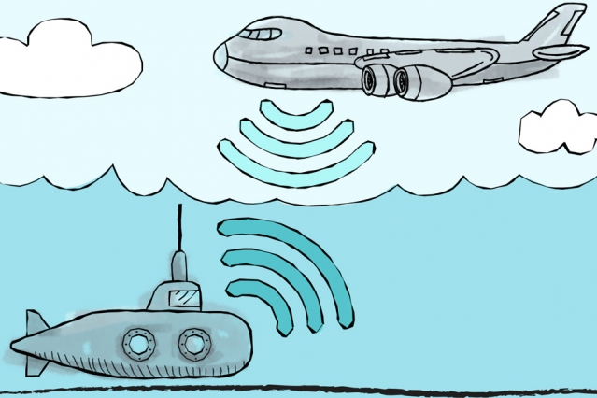
The necessity of Underwater Wireless Communication:
The wired underwater communication is not practicable in the following cases:
Temporary cases
Breaking of wires
Significant costs of deployment
Experiment over long distances

Slide 4
APPLICATIONS
The applications of the underwater wireless communication are as follows:
In the coming days, the applications could increase from myriad industries ranging from the offshore oil company to aquaculture and fishing industries.
It is also used in pollution control and climate recording.
It also has the application in the detection of the objects on the ocean floor.
Underwater wireless communication is also used in environmental monitoring and collecting of oceanographic information.
It has the application in marine archaeology, search and rescue machines and defense.
It is also used in seismic monitoring, pollution monitoring and ocean currents monitoring.
The underwater wireless communication is used in the equipment monitoring and control and also in the autonomous underwater vehicles (AUV).
It is also used in remotely operated vehicles (ROV).
It also has the application in the acoustic navigation technology for multiple autonomous underwater vehicles.
It is used in solar-powered autonomous underwater vehicles.

Slide 5
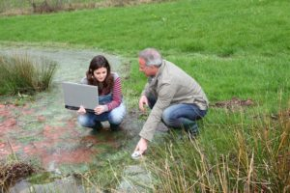
Environmental Monitoring
It monitors soil water and mineral content for irrigation, soil conditions for sports field monitoring, soli movement for landslides prediction.
It also monitors coalmine, glacier movement and earthquake monitoring.
It is also deployed for monitoring a golf course by monitoring soli salinity, water content and temperature

Slide 6
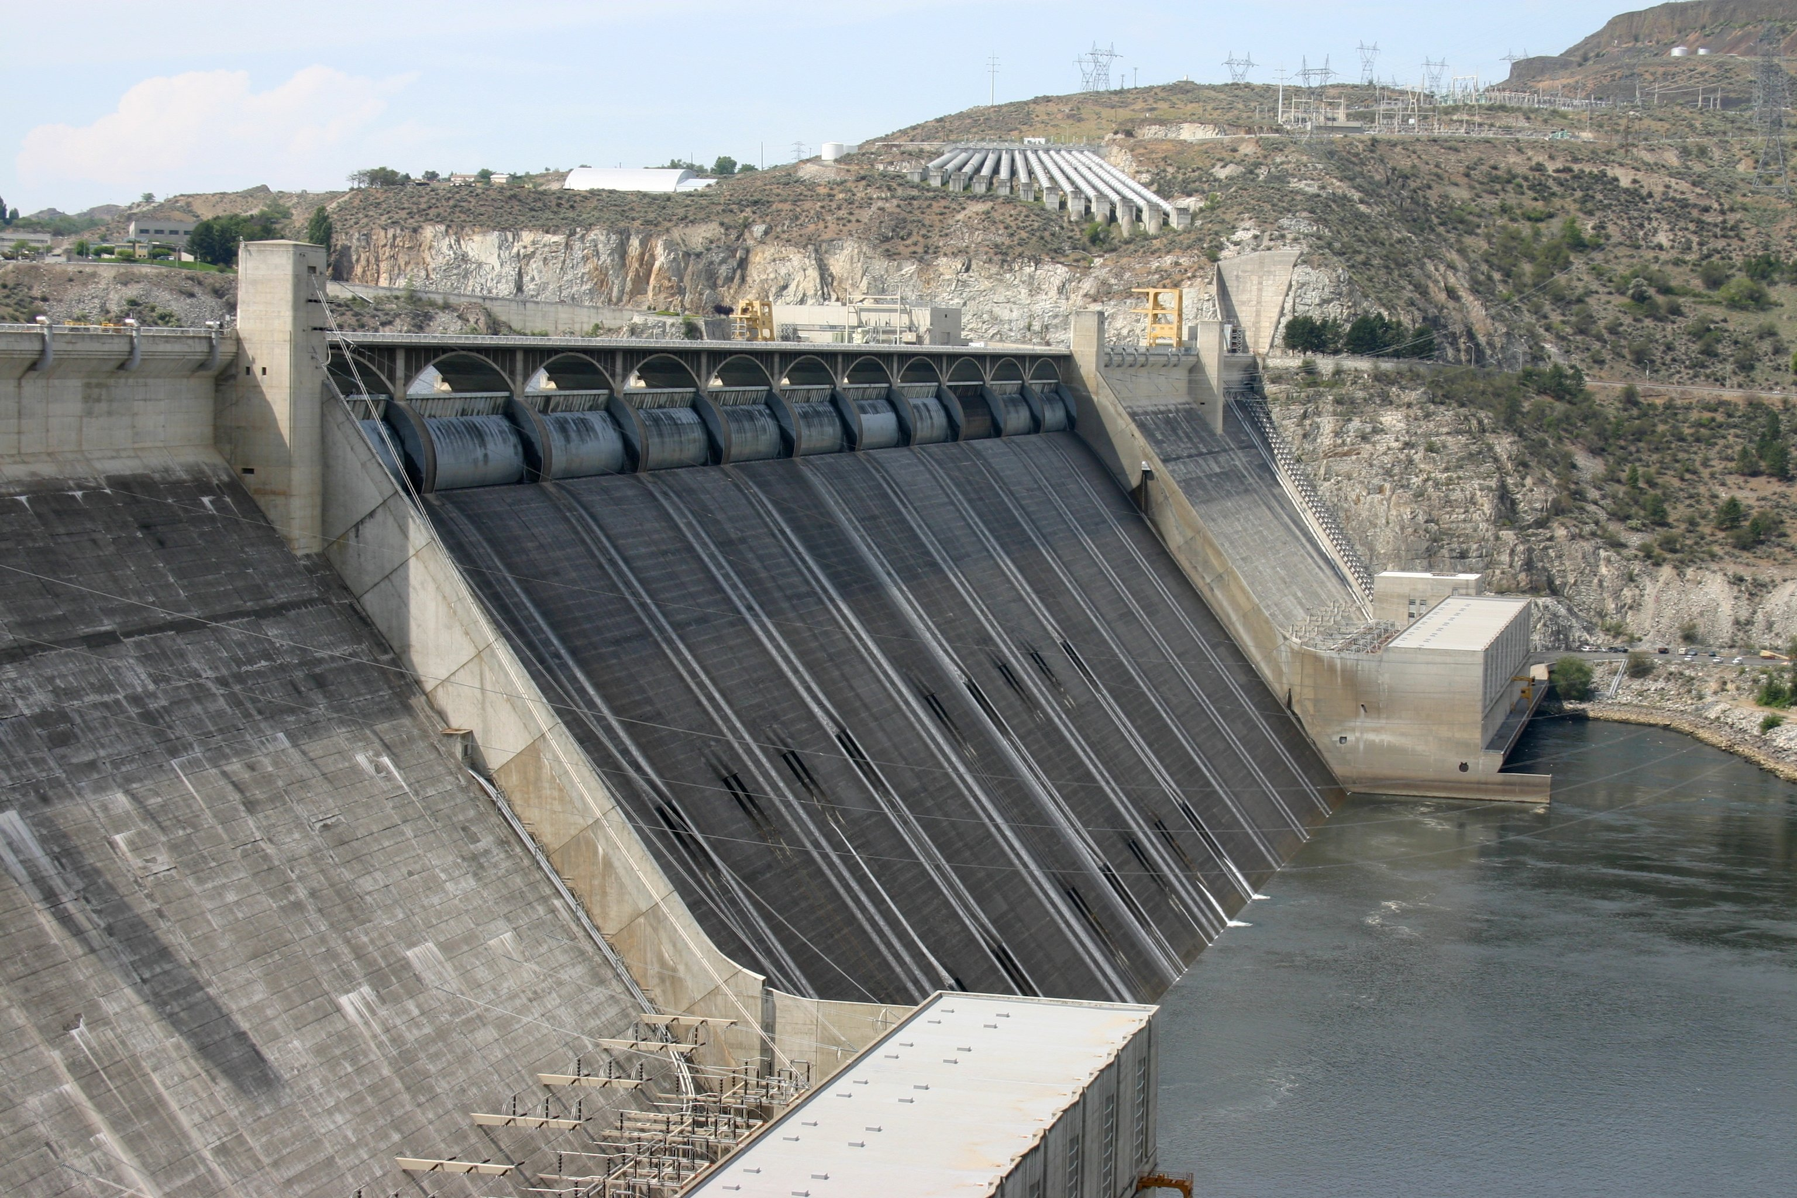
Infrastructure Monitoring
In infrastructure monitoring the sensors monitors the infrastructure of the pipe, wiring and underground components like dams and the minefields.
In this application, the sensors also deploy for the location determination of objects, which includes driver alert, autonomous fertilizer unit, and in case of building collapse it locate people.

Slide 7
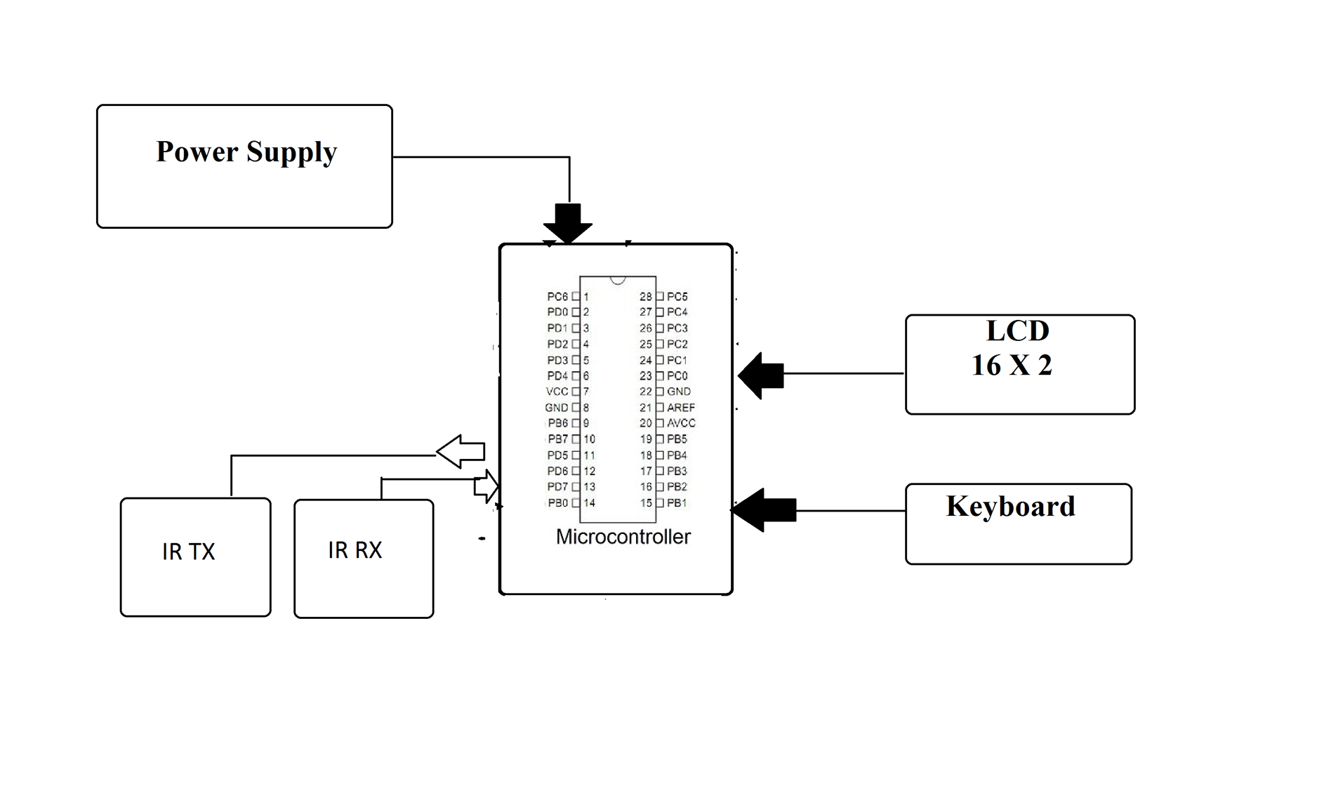
CIRCUIT DIAGRAM

Slide 8
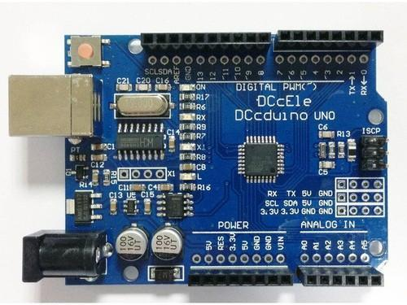
HARDWARE REQUIRED
ARDUINO UNOS:
The Arduino Uno is an open-source microcontroller board based on the Microchip ATmega328P microcontroller and developed by Arduino.cc. The board is equipped with sets of digital and analog input/output pins that may be interfaced to various expansion boards and other circuits.

Slide 9
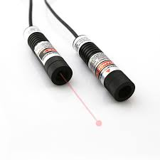
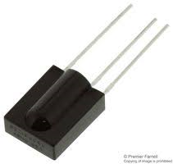
HARDWARE REQUIRED
INFRARED LASER
Infrared light to send the message which can be modulated and coded
INFRARED SENSOR
The infrared light is received by this sensor and the values are send for decoding

Slide 10
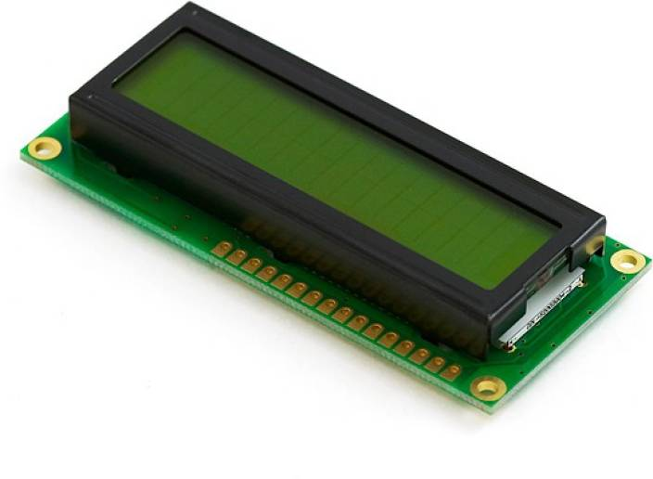
HARDWARE REQUIRED
LCD DISPLAYS:
A liquid-crystal display is a flat-panel display or other electronically modulated optical device that uses the light-modulating properties of liquid crystals combined with polarizers. Liquid crystals do not emit light directly, instead using a backlight or reflector to produce images in color or monochrome

Slide 11

SOFTWARE REQUIRED
ARDUINO IDE:
The Arduino Integrated Development Environment is a cross-platform application that is written in functions from C and C++. It is used to write and upload programs to Arduino compatible boards, but also, with the help of 3rd party cores, other vendor development boards

Slide 12
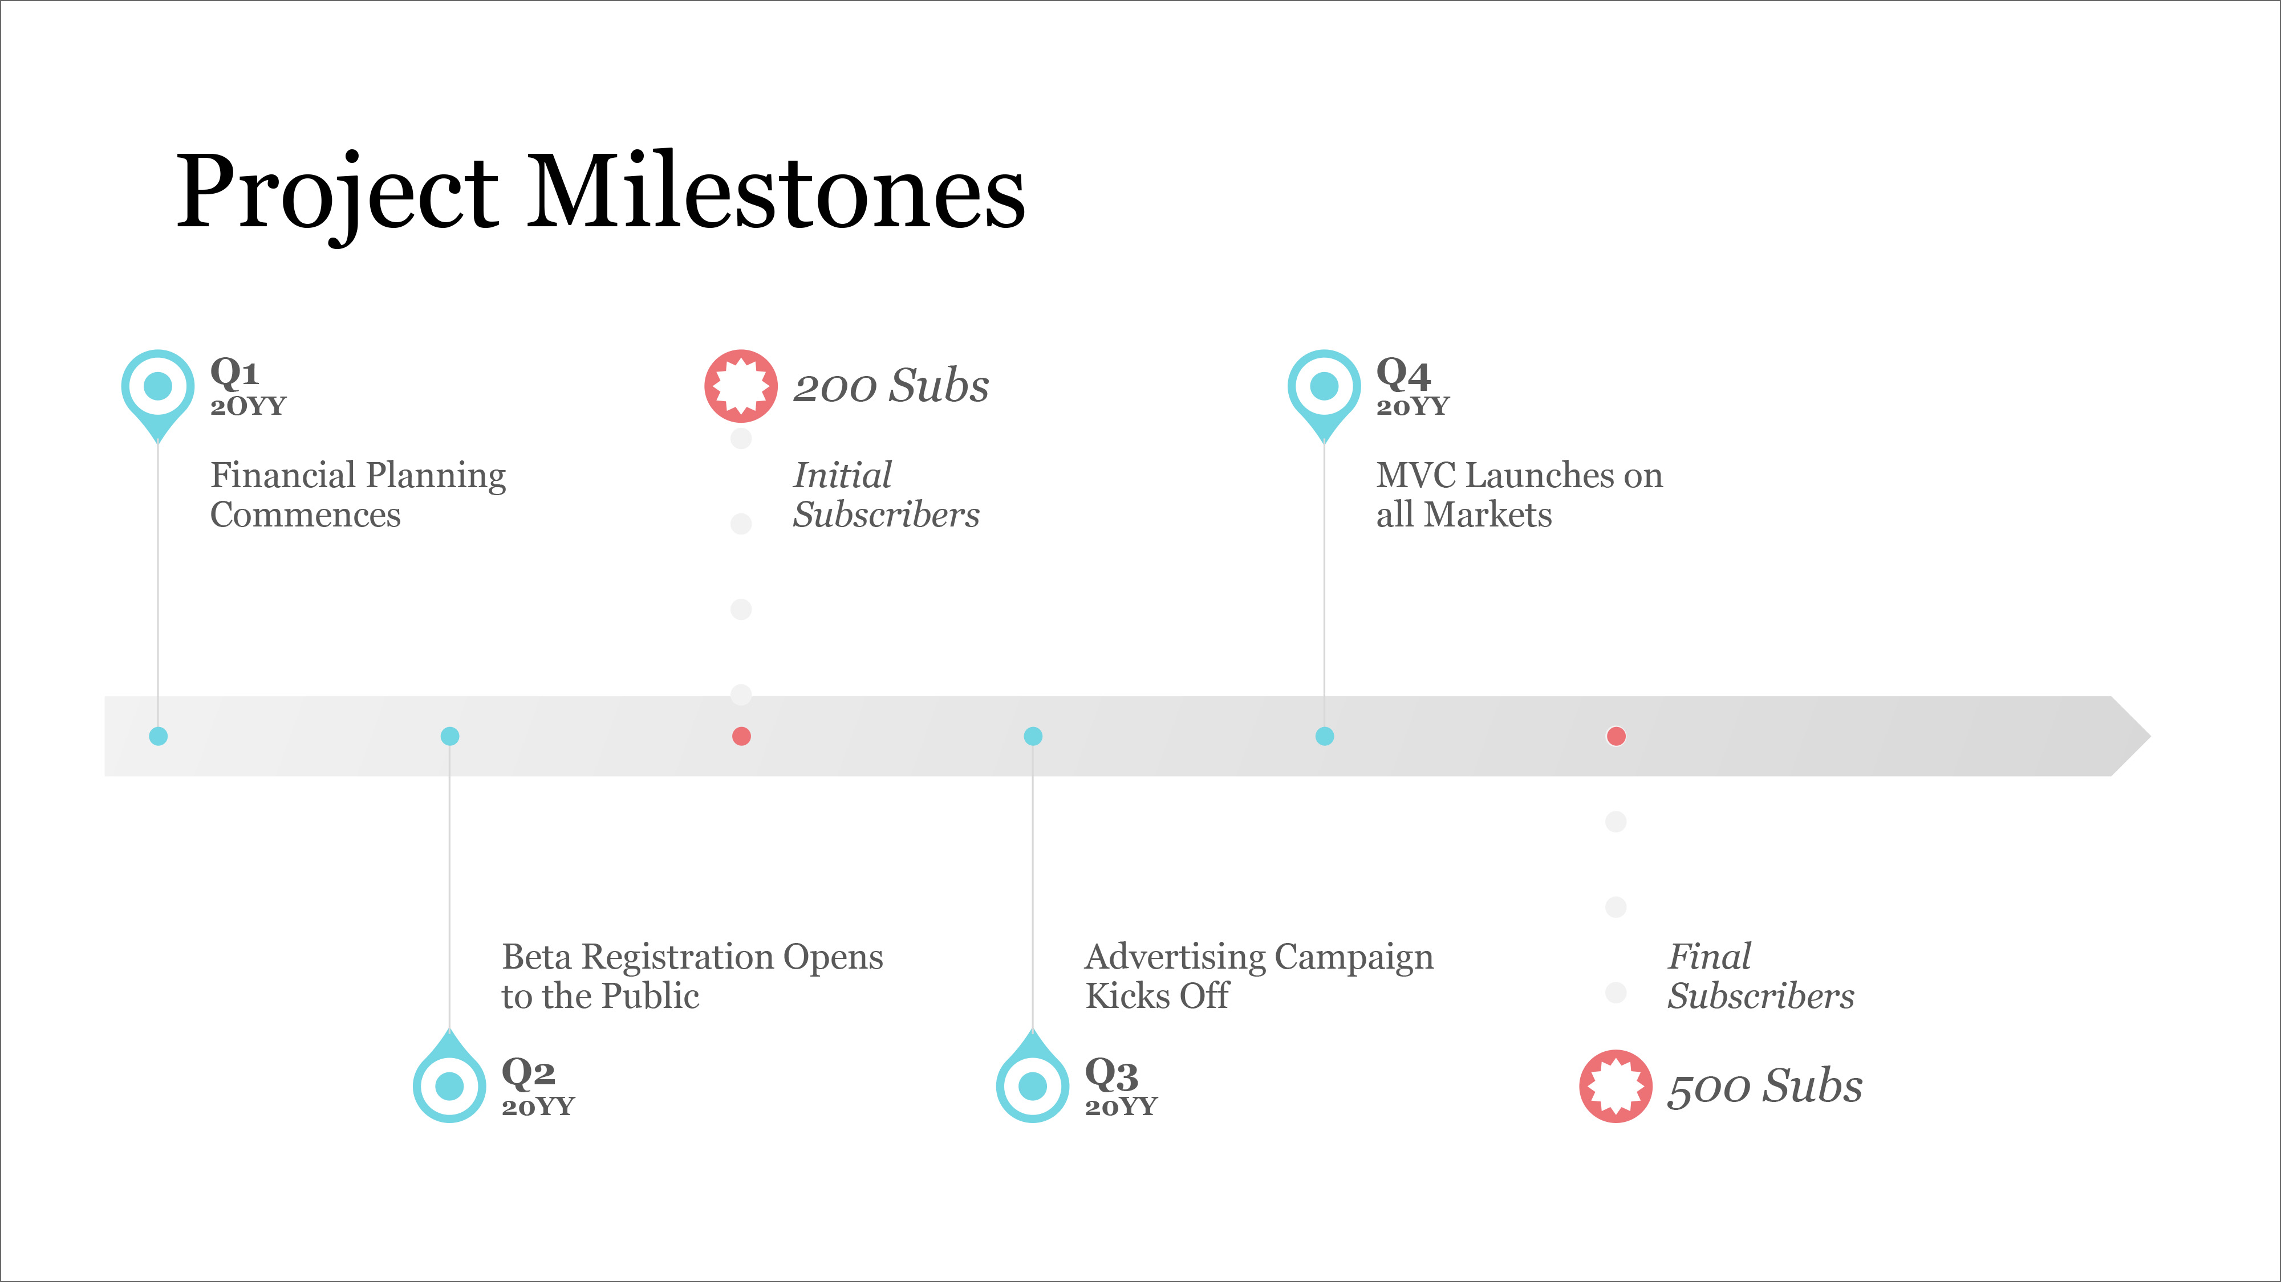
TIMELINE
BUY MATERIALS
CHECK THE WORKING OF CIRCUIT
TESTING AND DEBUGGING
CODING AND SOFTWARE IMPLEMENTATION
FINAL IMPLEMENATION AND OUTPUT
SIMULATE THE CIRCUIT

Slide 13


